Slide 1
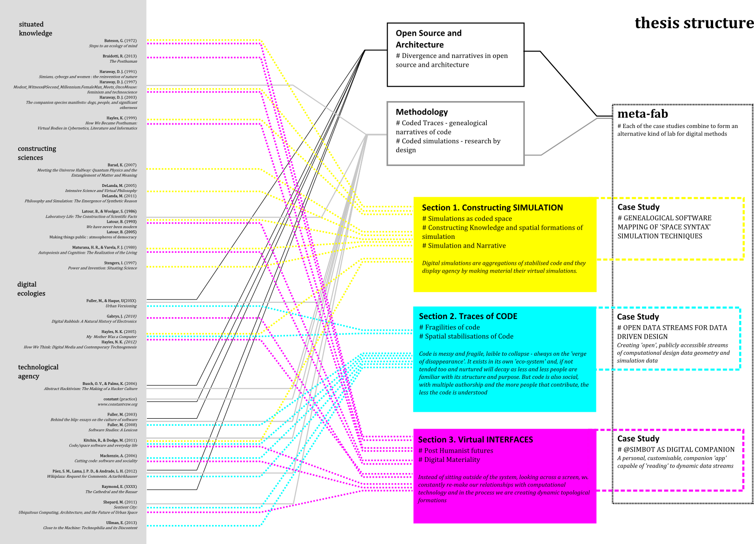
[De] Coding Architecture
Open source methods of spatial simulation

Slide 2
[De] Coding Architecture
Open source methods of spatial simulation
Situating Simulations
- Constructing Knowledge and spatial formations of simulation
- Simulation and Narrative
Traces of Code
- [In]stabilisations of code
- Spatial stabilisations of Code
Virtual Interfaces
- Post Humanist futures
- Digital Materiality

Slide 3
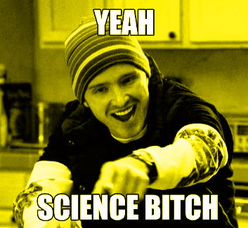
Situating Simulations
- Constructing Knowledge and spatial formations of simulation
- Simulation and Narrative
"Technologies and scientific discourses can be partially understood as formalizations i.e. frozen
moments, of the fluid social interactions constituting them, but they should also be viewed as instruments
for enforcing meanings"
(Haraway 1991:164)

Slide 4
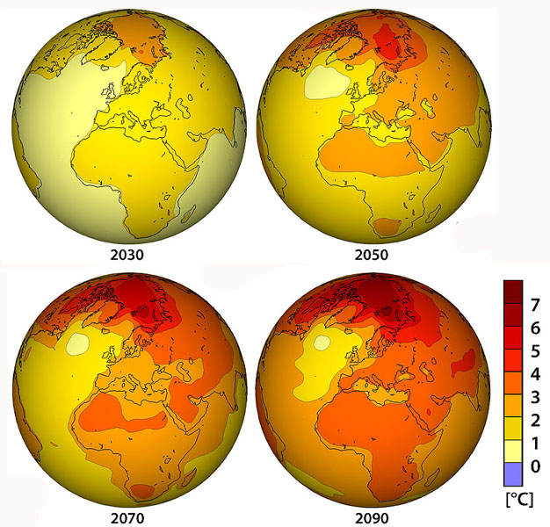
“...the objects of scientific research are at once discursively constructed, socially produced and materially real...”
(Hayles 2005:209)
"The models analyse the world, the world responds to the models."
(Kitchin and Dodge 2011:30)

Slide 5
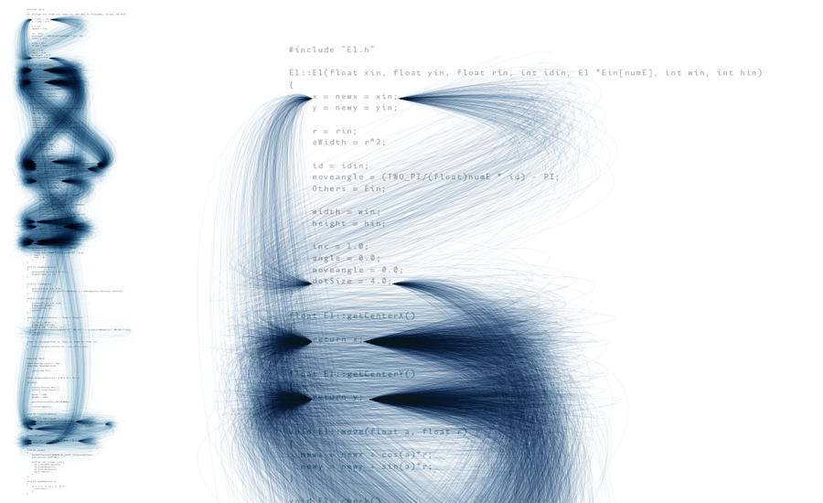
Traces of Code
- [In]stabilisations of code
- Spatial stabilisations of Code
“It has occurred to me that if people really knew how software got written I'm not sure they'd give their
money to a bank, or get on an airplane again.”
(Ullman 2013:2)
deprocess
(Ben Fry)

Slide 6
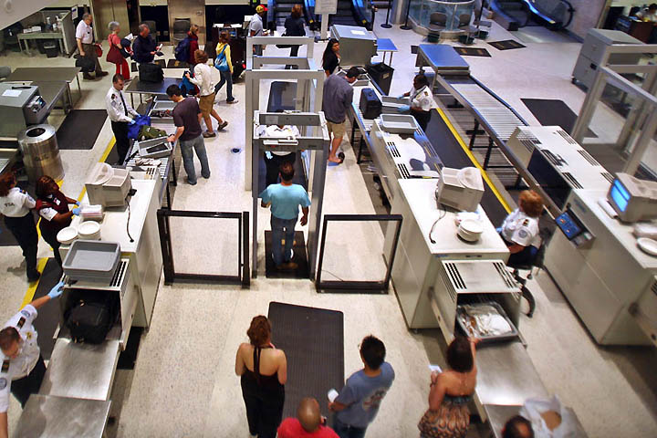
Stabilisations of code....
Code becomes algorithm, algorithm becomes software, and, through software, the virtual becomes material.
"Code/ Space occurs when software and the spatiality of everyday life becomes mutually constituted, that
is, produced by one another."
(Kitchin and Dodge 2011:16)

Slide 7
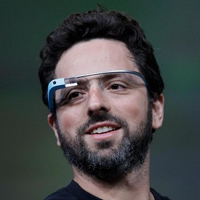
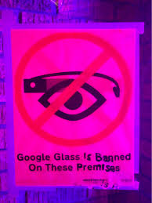
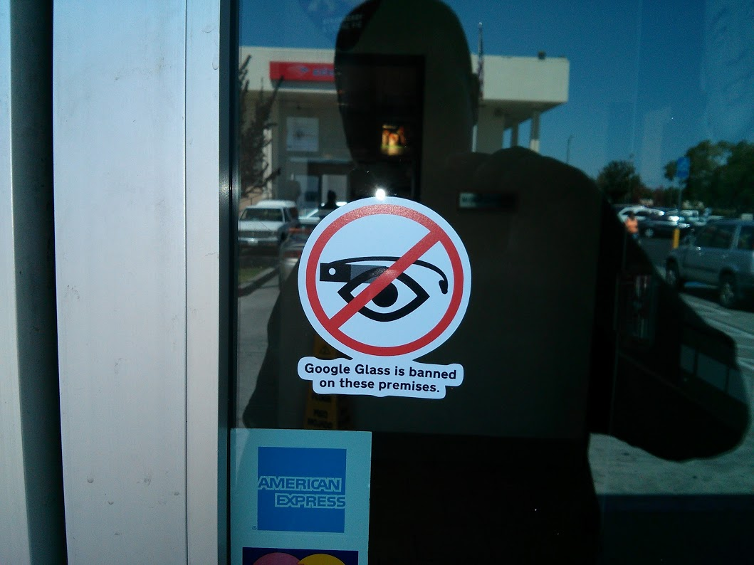
Virtual Interfaces
- Post Humanist futures
- Digital Materiality
"...my dream is a version of the post human that embraces the possibilities of information technologies
without being seduced by fantasies of unlimited power and disembodied immortality, that recognizes and
celebrates finitude as a condition of human being, and that understands human life is embedded in a
material world of great complexity, one on which we depend for our continued survival."
(Hayles 1999:5)

Slide 8
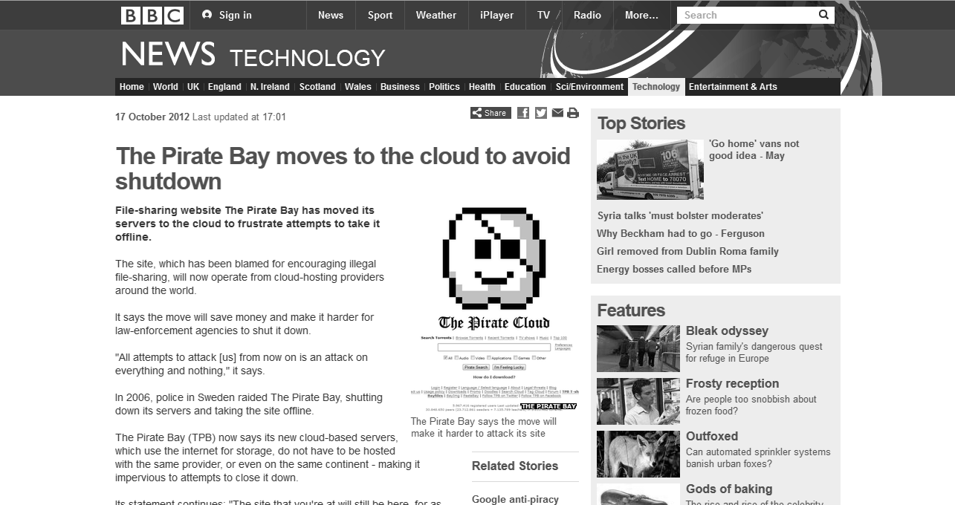
Virtual Interfaces
- Post Humanist futures
- Digital Materiality
"Yet the term de-materialised does not necessarily mean “without material” but may, instead, refer to
modes of materialization that render infrastructures imperceptible or ephemeral."
(Gabrys 2010:51)

Slide 9

@simulationBot

Slide 10
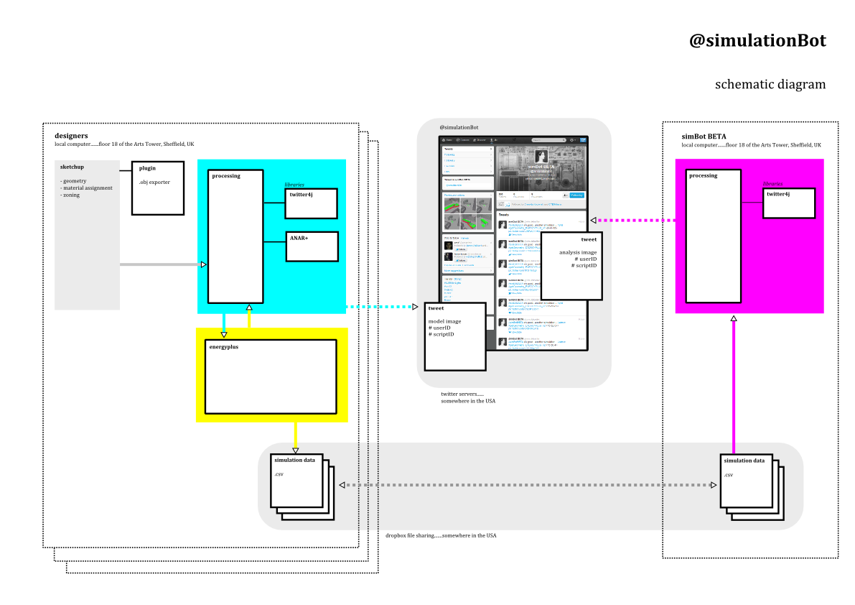
@simulationBot

Slide 11
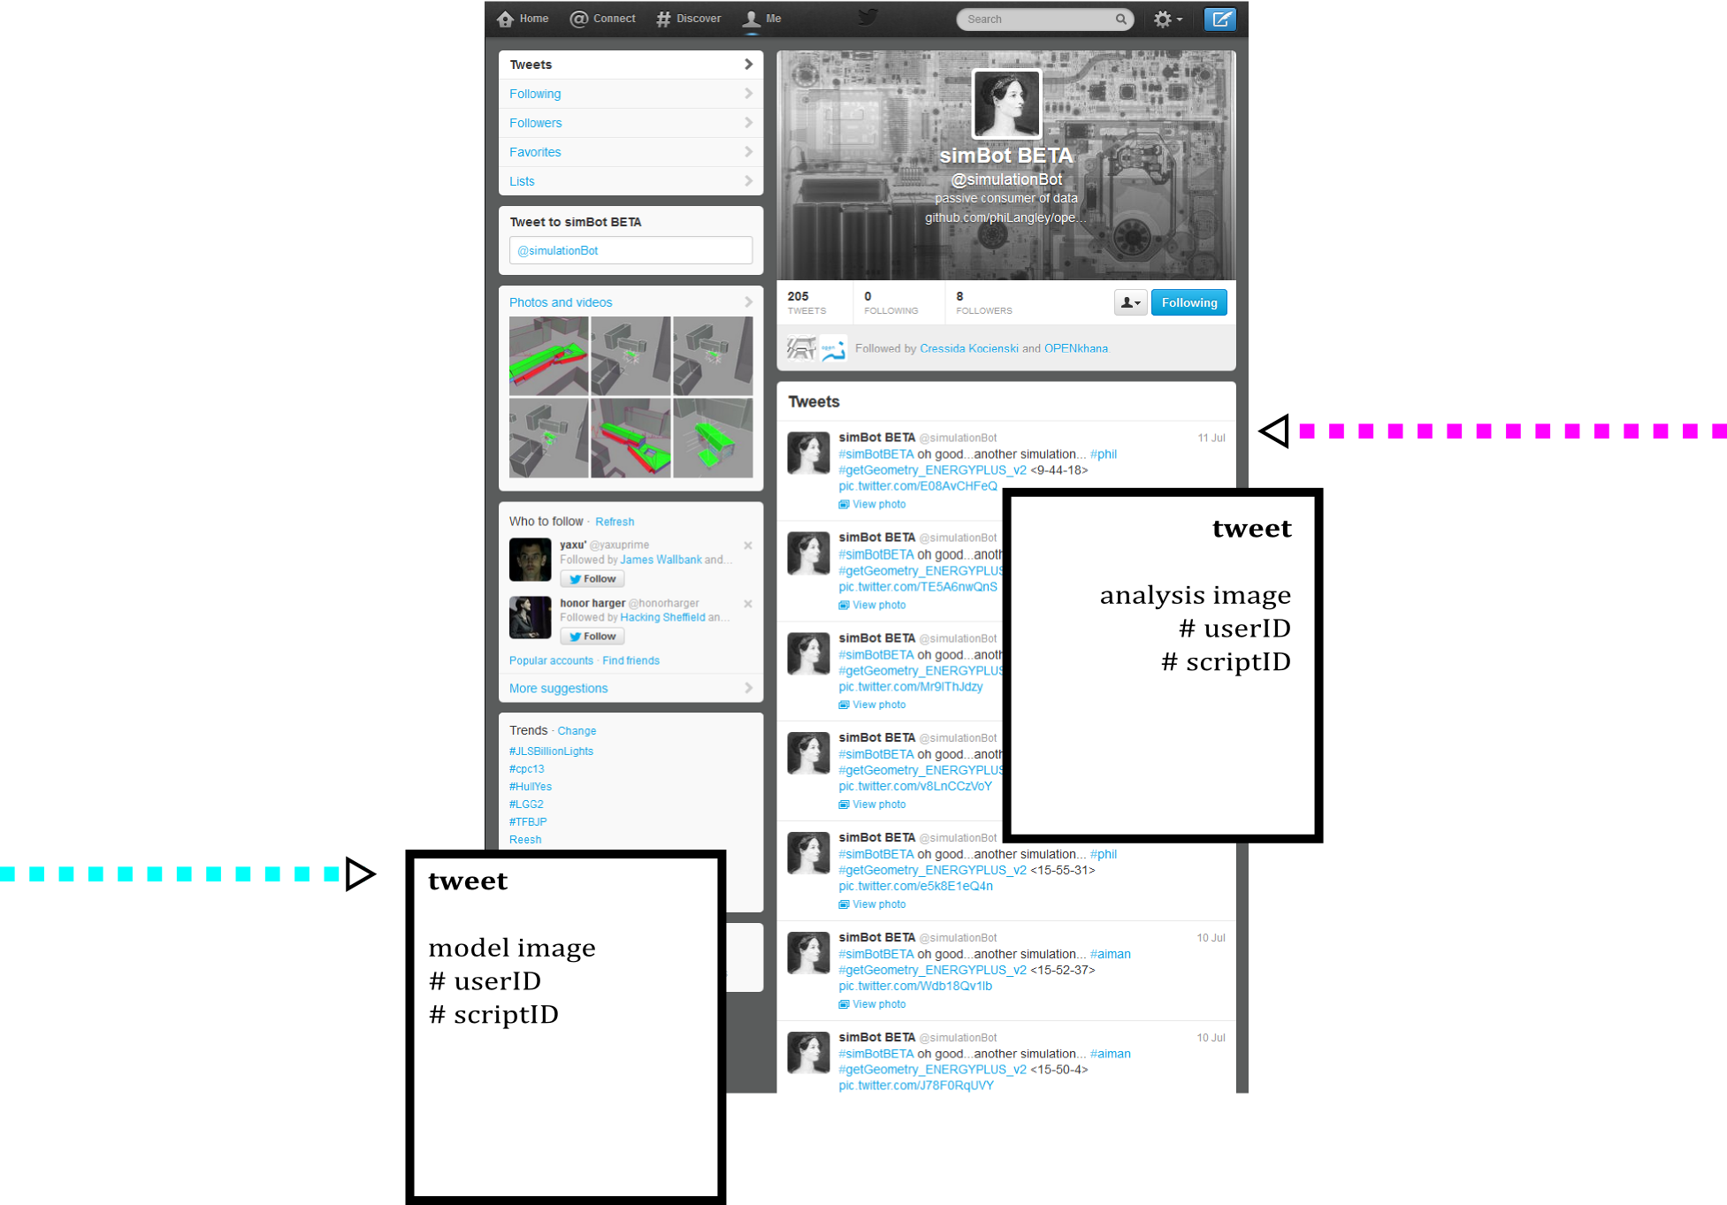
@simulationBot

Slide 12
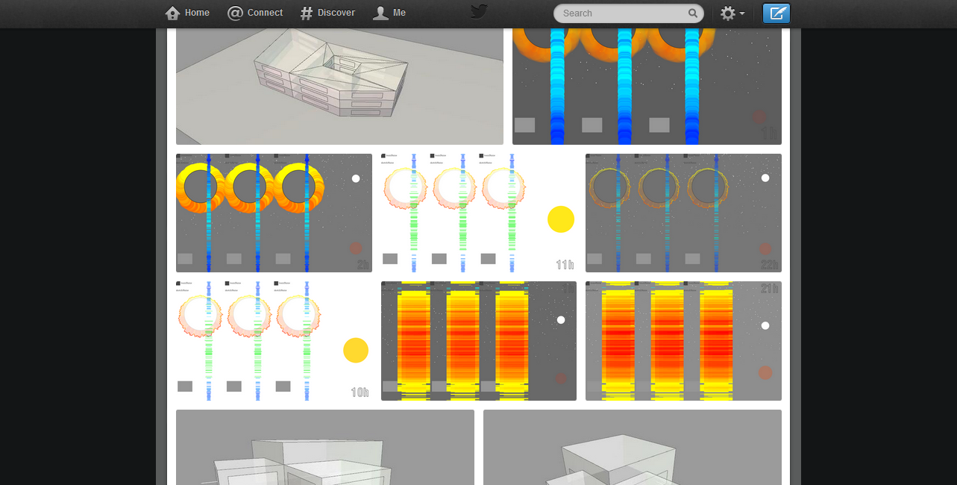
@simulationBot

Slide 13
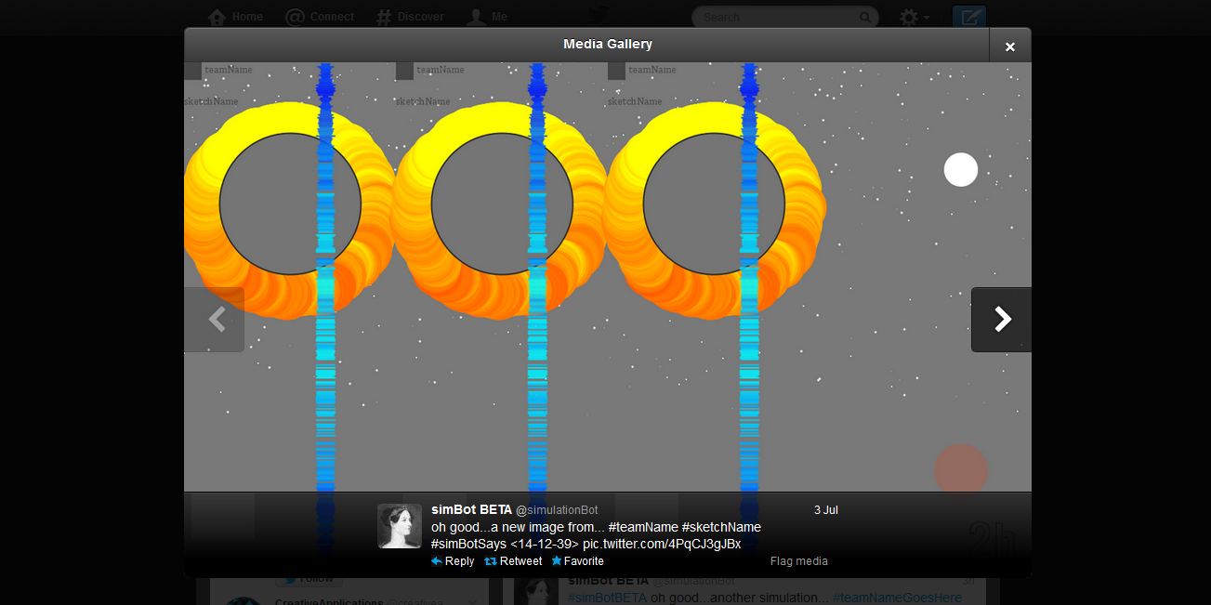
@simulationBot

